Slide 1

DAYALBAGH EDUCATIONAL INSTITUTE
FACULTY OF SCIENCE
CLASS - BACHELOR OF VOCATION
BRANCH - INTERNET OF THINGS
COURSE NAME – PROJECT III
COURSE CODE – ITV 308
TOPIC -FINGERPRINT BASED BIOMATRIC ATTENDANCE SYSTEM
SUBMITTED TO -
AMARJEET SINGH CHAUHAN
SUBMITTED BY -
NAME: RAHUL KUMAR
ROLL NO: 2204267

Slide 2

Fingerprint Based Biometric Attendance
System using Arduino
1

Slide 3
Attendance systems are commonly used systems to mark the presence in
offices and schools. From manually marking the attendance in attendance
registers to using high-tech applications and bio-metric systems,
these systems have improved significantly.
It is widely accepted that a proper attendance management system is crucial
for any kind of institution. Since there are a lot of practical issues involved in
paper-based manual attendance methods, nowadays almost all companies
have automated their process of attendance management.
2

Slide 4
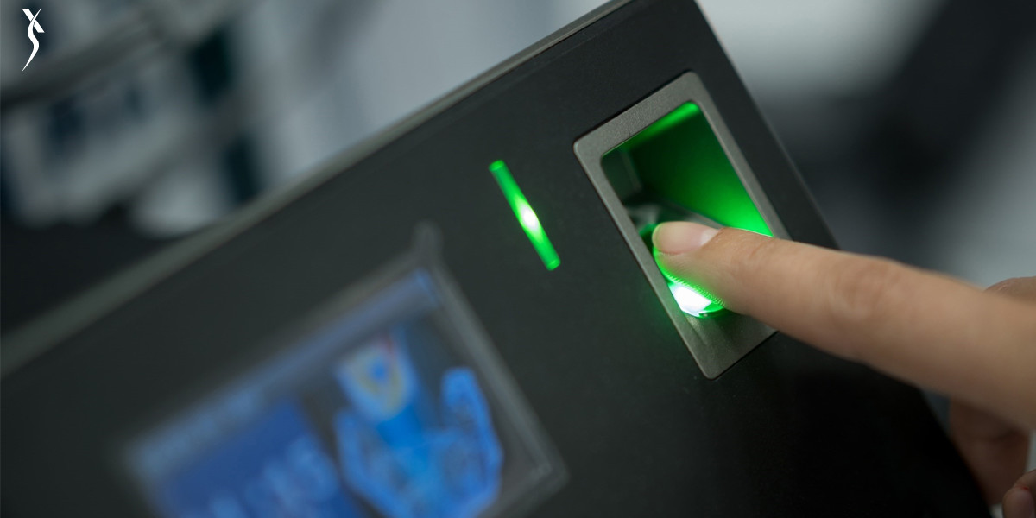
Understanding Fingerprint-Based Biometric Attendance System
Fingerprint biometrics is based on the unique patterns of ridges and furrows present on an individual's fingertips. These patterns are virtually impossible to replicate, making fingerprints an ideal identifier for biometric applications. A Fingerprint-Based Biometric Attendance System using Arduino utilizes this unique trait to provide an accurate and secure method of recording attendance.
3

Slide 5
Components Required
Arduino Uno
16x2 LCD
RTC Module (Real Time Clock Module DS3231/DS1307)
Fingerprint Senser Module ( R305/R307 Fingerprint Sensor)
Push Buttons
SPST Switch
3V Battery for RTC Module
Li-Ion Rechargeable Battery
connector wires
Buzzer
Red LED
Bread Board
Plastic BOX
4

Slide 6
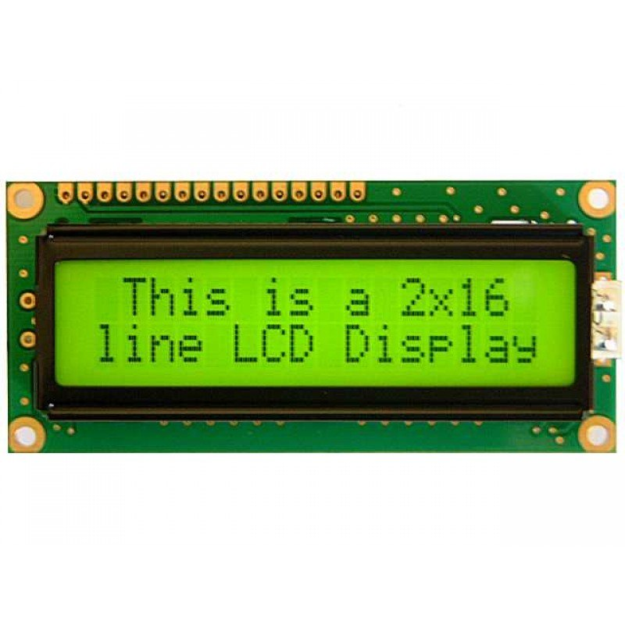
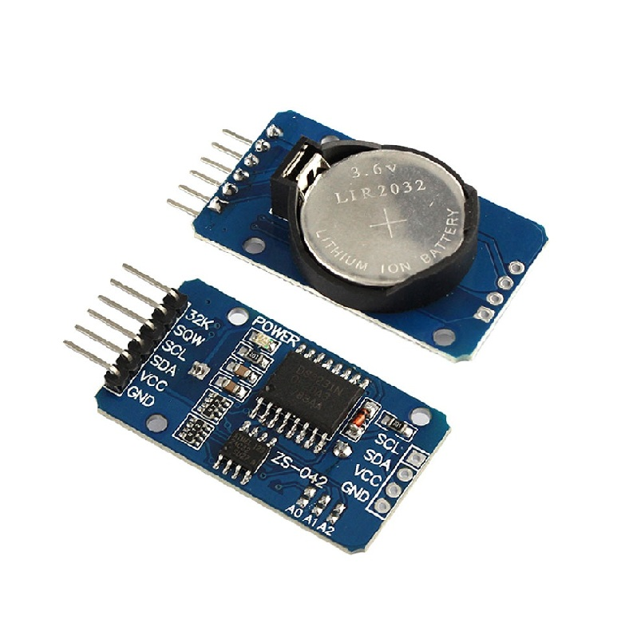
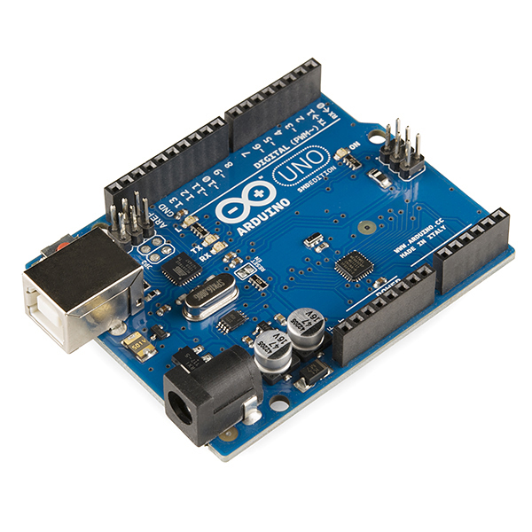
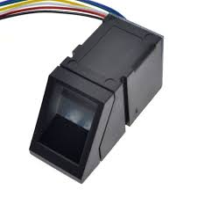
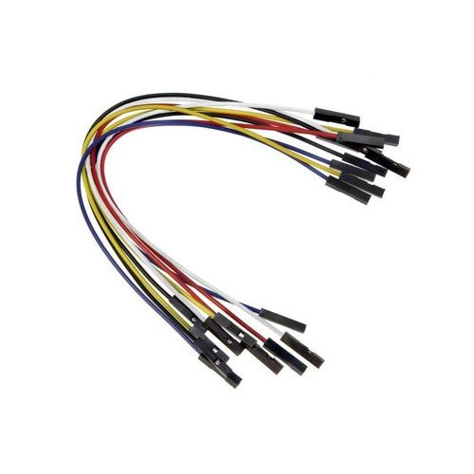
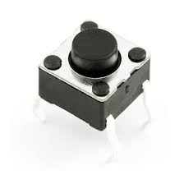
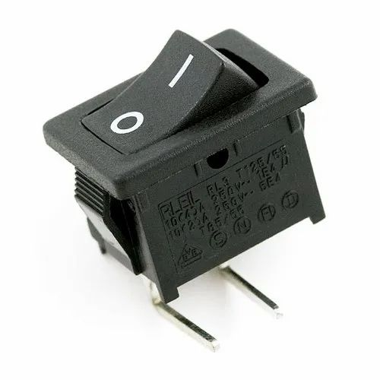
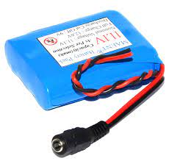
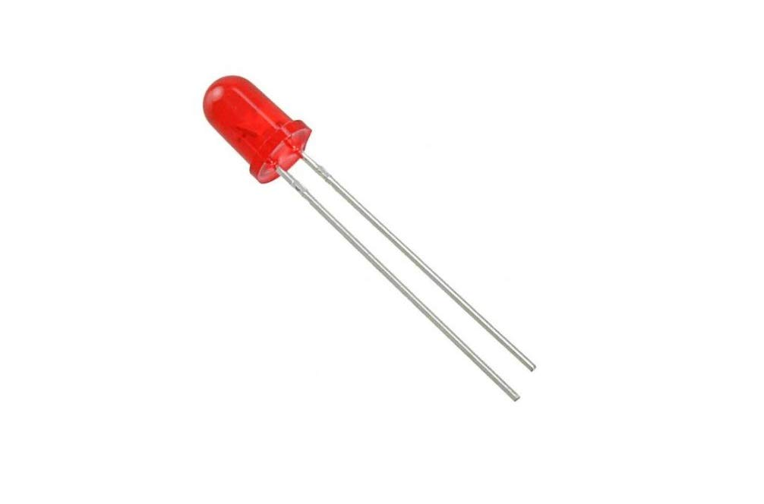
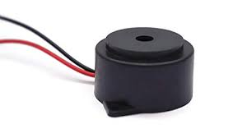
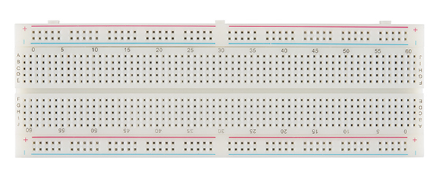
5

Slide 7
Understanding the Components
The heart of our fingerprint-based biometric attendance system is the Arduino microcontroller, a versatile and widely used open-source platform. Alongside Arduino, we will require a few essential components to build the system:
6

Slide 8
Arduino Uno: Arduino UNO is a low-cost, flexible, and easy-to-use programmable open-source microcontroller board that can be integrated into a variety of electronic projects.
Fingerprint Sensor: This module scans and captures the unique fingerprint patterns of individuals. It then converts the fingerprints into digital data for further processing.
Display Module: An LCD display is utilized to provide real-time feedback, such as attendance status or instructions to users.
Buzzer: A simple audio output device, such as a buzzer, can be incorporated to provide auditory cues during various events, like successful authentication or errors.
RTC Module: a digital clock with a primary function to keep accurate track of time even when a power supply is turned off or a device is placed in low power mode.
Li-Ion Rechargeable Battery: A lithium-ion battery is a type of rechargeable battery that is charged and discharged by lithium ions moving between the negative (anode) and positive (cathode) electrodes.
7

Slide 9
How it Works
Enrollment: The system administrator enrolls individuals by capturing their fingerprints using the fingerprint sensor. The unique fingerprint data is then stored in the Arduino's memory along with their corresponding identities.
Authentication: When a person needs to mark their attendance, they place their finger on the fingerprint sensor. The sensor captures the fingerprint and converts it into digital data.
Matching Algorithm: The Arduino compares the captured fingerprint data with the stored templates using an advanced matching algorithm. If a match is found, the individual's identity is verified.
8

Slide 10
Attendance Marking: Once the identity is verified, the system marks the attendance in real-time, and the LCD display may show a success message or the person's name.
Error Handling: In case of an unsuccessful match, the system can prompt the user to try again or display an error message on the LCD screen.
Admin Features: For administrative purposes, the system may include an additional level of security through a keypad, enabling authorized personnel to access attendance records or add new users.
9

Slide 11
Setting Up the Hardware:
Step 1: Connect the fingerprint sensor module to the Arduino using jumper wires.
Step 2: Connect the LCD display to the Arduino to show attendance details.
Step 3: Download and install the necessary libraries for the fingerprint sensor and LCD display.
Step 4: Programming the Arduino Write the code to interface the fingerprint sensor with the Arduino board. The code should include functions for fingerprint enrollment and recognition. During enrollment, each employee's fingerprint is scanned and stored in the system's database. During recognition, the system matches the scanned fingerprint with the stored data to identify the employee and record their attendance.
10

Slide 12
Step 5: Registering Employee Fingerprints: Now enroll new employees into the system by capturing and storing their fingerprints in the sensor's database.
Step 6: Attendance Marking: When the employee place their finger on the sensor. Arduino Match the scanned fingerprint with the stored templates to verify the employee's identity. If the fingerprint matches, mark the attendance and display a Attendance Register success message on the LCD display; otherwise, show Fingerprint not registerd message.
Step 6: Data Storage and Reporting: To download stored attendance in CSV file connect the arduino to the PC/Laptop open Arduino IDE app and then press two reset button (one of the rduino and another the push button which you set externaly ) together.
11

Slide 13
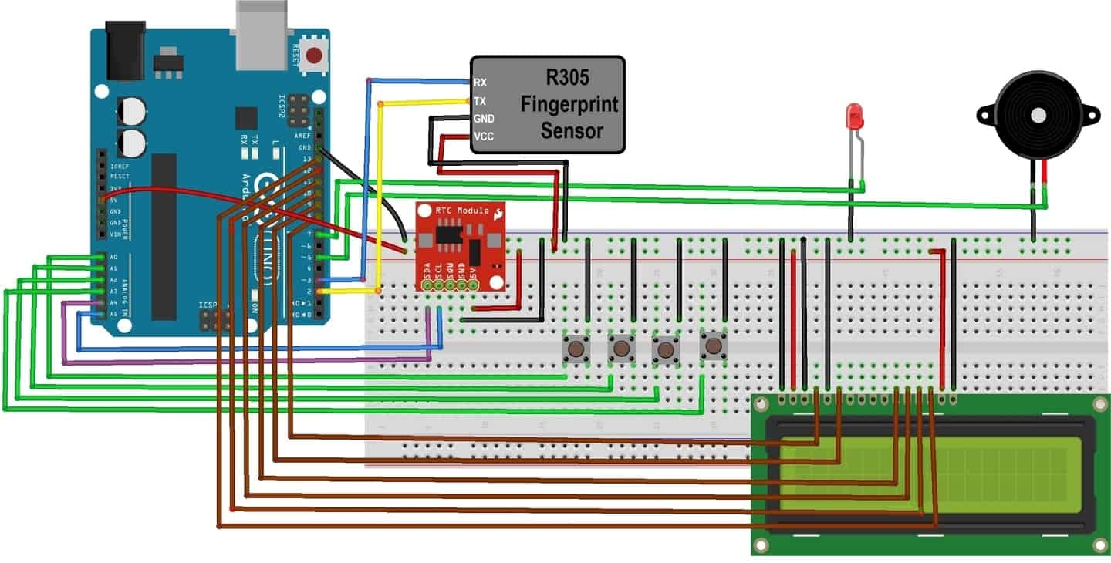
Circuit Diagram
12

Slide 14
Benefits of Fingerprint-Based Biometric
Attendance System
Accuracy: Fingerprint patterns are unique to individuals, making the system highly accurate in identifying users. This reduces the chances of proxy attendance or identity fraud.
Time-Efficient: The entire process of authentication takes only a few seconds, significantly reducing time wastage during attendance marking.
Cost-Effective: Compared to other biometric modalities, fingerprint-based systems are more affordable and require minimal maintenance.
Data Security: Fingerprint templates are stored securely within the Arduino's memory, reducing the risk of unauthorized access to sensitive data.
User-Friendly: The system is user-friendly and requires minimal training for individuals to use it effectively.
13

Slide 15
Conclusion
The Fingerprint-Based Biometric Attendance System using Arduino represents a significant leap in attendance tracking technology. By leveraging the uniqueness of fingerprints, this system provides an accurate, efficient, and secure solution for managing workforce attendance. With its ability to eliminate time theft and enhance overall productivity, organizations can enjoy streamlined operations and improved workforce management. As biometric technology continues to evolve, we can expect even more sophisticated solutions that further enhance security and efficiency in various aspects of our lives.
14

Slide 16
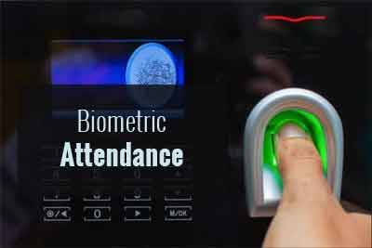
Thank you!
15

